Slide 1
Azure Sentinel Hunting
Hands-On Challenge

Slide 2
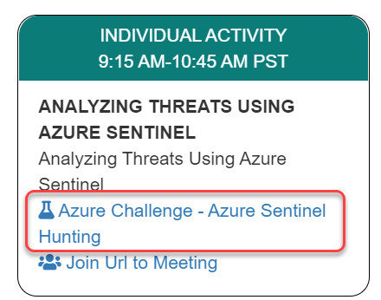
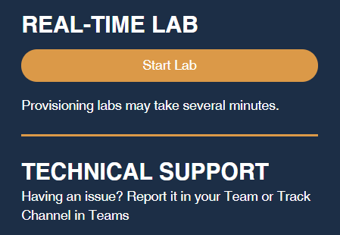
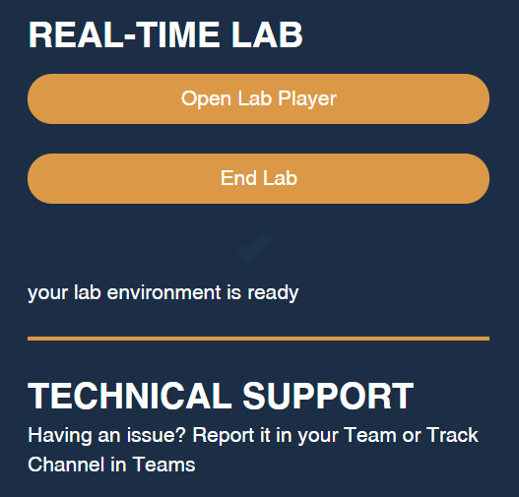
Launch the Lab Environment
Important! Allow at least 1 hour for your lab to start

Slide 3
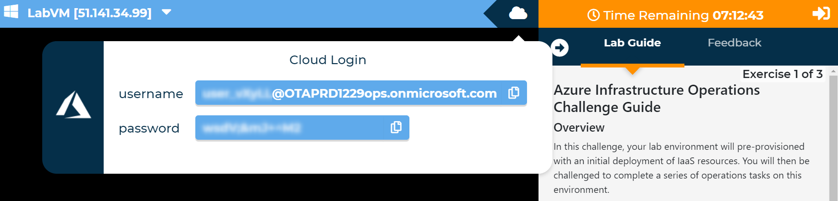
Access Your Lab
Important! Allow at least 1 hour for your lab to start

Slide 4
Challenges
Challenge 1: Understanding The Environment
Before you can extend and further configure Contoso Finance's Sentinel deployment, you need to understand what they have done to date and help them plan.
Challenge 2: Sentinel Alerting And Analytics
Now that you understand the data sources and volume of data that Contoso Finance is contending with, you can begin operationalizing the Sentinel deployment.
Challenge 3: Investigating Incidents
As alerts are generated and aggregated in incidents, you can begin hunting and making recommendations to Contoso Finance on how to improve their posture.
Note Automatic validation of your solution has been disabled to speed up the lab for you
Notes:
A new customer, Fruit Smashers, has approached to you take on the management and operations of one or more containerized applications which are hosted in an existing Azure Kubernetes Service (AKS) cluster. Currently, a popular website for rating fruit smoothie flavors - Fruit Smoothies by Fruit Smashers - is deployed in the cluster and a new application will be coming online shortly to allow guests to Fruit Smashers corporate headquarters to leave messages about the favorite part of their visit. While the existing platform and underlying deployment(s) meet the needs of the business, Fruit Smashers plans to grow their online presence significantly as more customers move to online ordering exclusively. They anticipate that growth will be organic and bursty.
The lab will not validate that each challenge has been completed correctly, so pay close attention to the requirements in each challenge.

Slide 5
Need help?
Use the Teams chat channel

